Slide 1
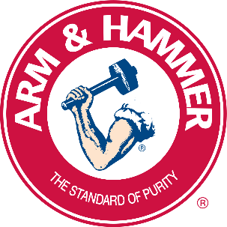
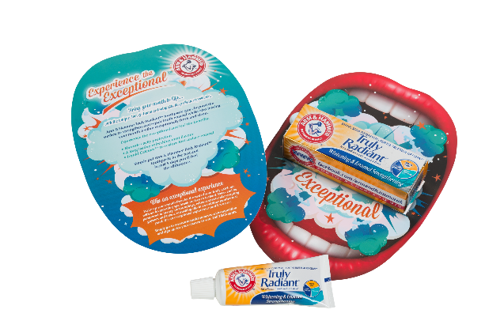
Arm & Hammer Sampling Helps Delivers
37% Increase in Sales
Arm & Hammer have become a trusted solution for more than 170 years. With a range of personal care products, including oral care harnessing the natural power of baking soda.
Strategy
With teeth-brushing being second nature and part of everyone's daily routine, brand loyalty is remarkably low for such a ubiquitous product. As the trend for teeth-whitening has taken hold, the number of products has proliferated even further, and consumer choice is now even more difficult.
The product's premium-price point drove the targeting strategy. Aiming the campaign at the wealthier, early-adopting households in the vicinity of Arm & Hammer stockists would be the sweet spot.
Creativity
The agency Communicator London used that unique clean feeling that comes from brushing with Arm & Hammer and created a strong visual, brought to life with gently rolling 'explosive clouds', evocative of the deep clean refreshment. The refreshing feeling was further dramatized with a chance to win an exhilarating balloon ride. In keeping with the product's gently refreshing efficacy, prize winners would get to experience the cool, exhilarating rush of cruising through white clouds.
A money-off voucher also helped reinforce re-purchase.
Results
95% of people recalled the sample
85% of people went on to use it
65% of the people who received the sample went on to
purchase Arm and Hammer.
The same creative also ran in-store at local pharmacies
in the catchment area. Data showed that, in tandem with
the door drop, this led to a 37% increase in sales
The campaign won a DMA Bronze Award
GET IN TOUCH
01628 703 693
whistl.co.uk/enquiries

